Slide 2
Initial Responder Protocol
Incident Command System in Schools
OASSN Updates
Lunch (with Discussion Tables)

Slide 3
The purpose of the OASSN is to bring together all relevant parties…
… to work toward regional-based solutions to common safety and security issues facing K-12 educational institutions.

Slide 4
Goals
To learn the operational mission and cultures of each organization
To promote a culture of “regional school safety” and foster a “community of practice”
Leverage the total region to pursue grants and other opportunities
To coordinate emergency response components
To improve planning, building and systems design, etc. to better prevent incidents and to promote quick resolution

Slide 5
Collaboration Groups
Physical &
Mental Health
Policy & Legal
Facilities
Public Information
Transportation
Information Tech &
Communication Systems
Planning & Training

Slide 6
Collaboration Groups
Name:
Email:
L
Physical &
Mental Health
P
Policy & Legal
Facilities
N
Public Information
Transportation
Information Tech &
Communication Systems
P
L = Lead
P = Participant
N = Need Info
Planning & Training

Slide 7
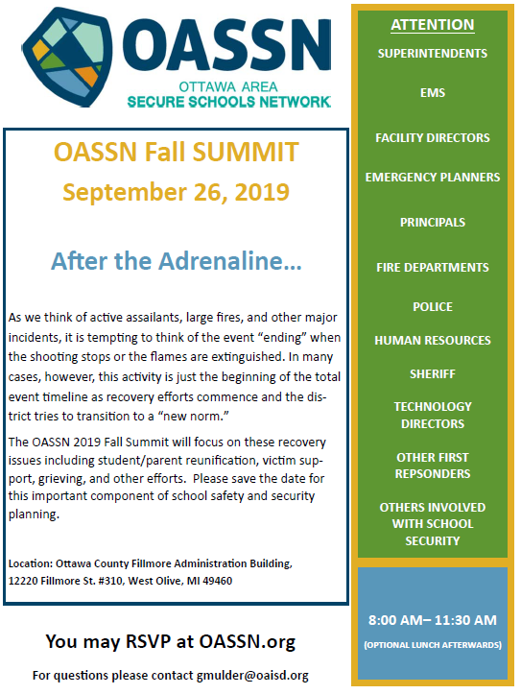

Slide 8
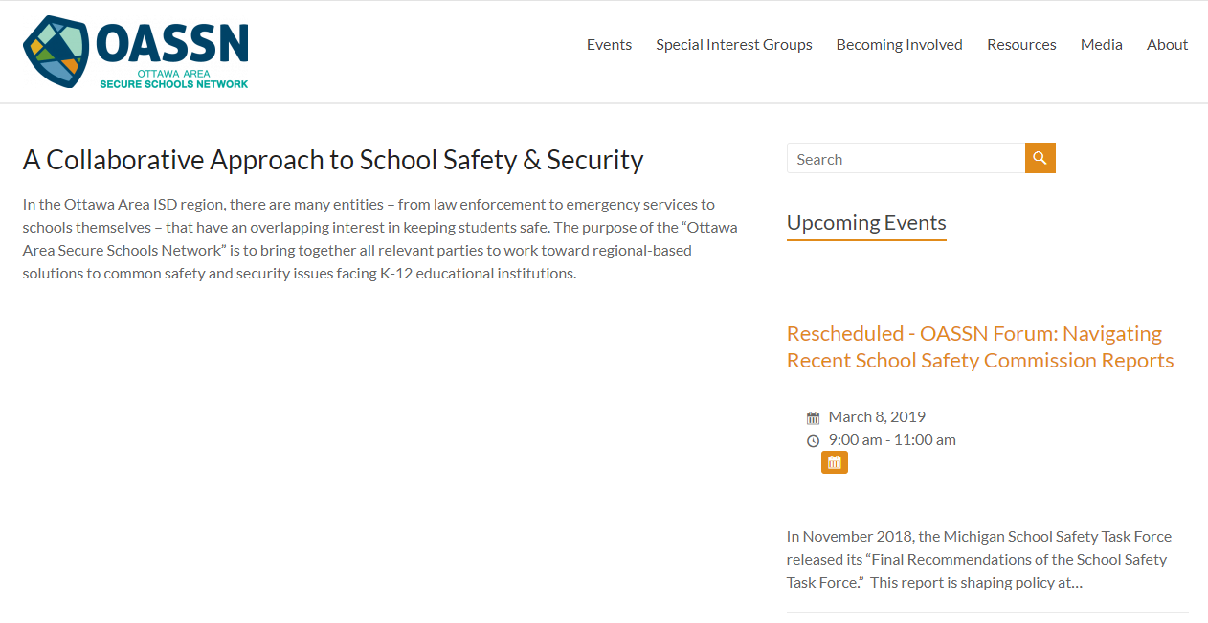
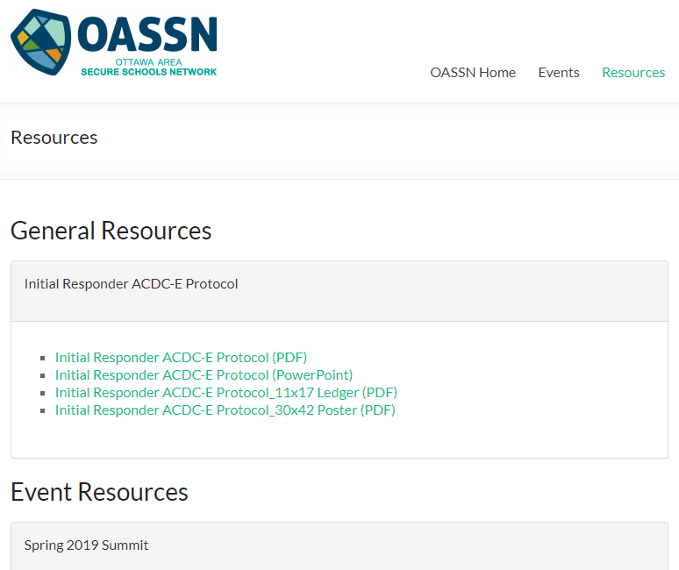
oassn.org

Slide 10
Media Sources
The Blues Brothers (1980) – Everybody Needs Somebody to Love Scene (audio only): https://www.youtube.com/watch?v=EHV0zs0kVGg
Sound Effect – Loud Fire Alarm: https://www.youtube.com/watch?v=0F6yhQ6hG9s
Mission Impossible Theme Tune: https://www.youtube.com/watch?v=dWfLThXoC8Y
90 second countdown timer: https://www.youtube.com/watch?v=EVTggsSfHj8&t=5s
Jessica Blakely singing Inter Planet Janet from School House Rock: https://www.youtube.com/watch?v=ROkWlf9jL5M
Massive Brawl at Vigor-Faith Academy Basketball Game: https://www.youtube.com/watch?v=5X_f_sOytE4
Mikayla’s 3rd Grade Recorder Concert (audio only): https://www.youtube.com/watch?v=bHD2QrRIbRw
Basketball Crowd Noise 01 Sound Effect: https://www.youtube.com/watch?v=hZMkqoLcDTs&t=316s

